Slide 1

THICK
MARGIN
Notes:
In order to use these guides in a new deck or your existing deck, simply copy the slide with the guide you want to use, let’s say normal margin. Go to the deck you wish you apply the guide, right click the thumbnail panel, click on the second button which is Paste Source Formatting, to move the master slide with the guide over. You can then select all your slides, go on to Layout under the Home tab, and choose the master slide with the guide.

Slide 2
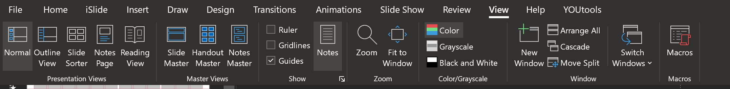
View and Hide Guides
Go to View tab and check 'Guides'
Quick shortcut: Press Alt+F9 to toggle guides on/off

