Slide 1

ULTRA-THIN MARGIN

Slide 2
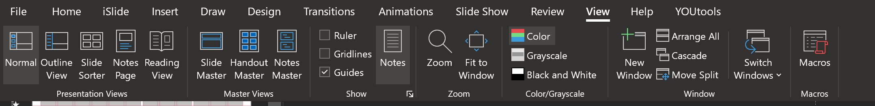
View and Hide Guides
Go to View tab and check 'Guides'
Quick shortcut: Press Alt+F9 to toggle guides on/off

